Slide 1
CS 39006: Network Lab – Explore Application Layer Protocols

Slide 2
Protocol Stack Implementation in a Host
Application
Software, Kernel
Transport
Network
Data Link
Firmware, Device Driver
Physical
Hardware

Slide 3
Application Layer Protocols
Web
(HTTP)
File Transfer
(FTP)
UDP
TCP
End to end packet delivery
Connection Establishment
Reliable Data Delivery
Flow and Congestion Control
Ordered Packet Delivery
Transport
Network
Data Link

Slide 4
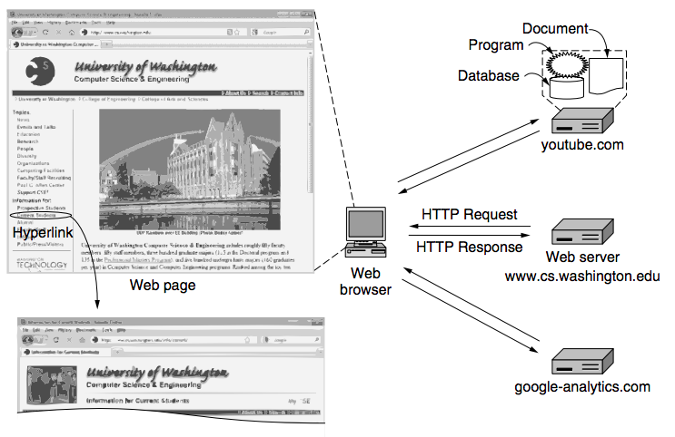
The Web – Architectural Overview
Source: Computer Networks (5th Edition) by Tanenbaum, Wetherell

Slide 5
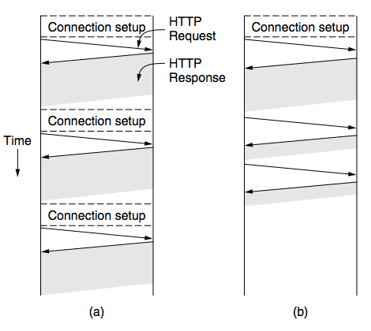
Connections
Persistent Connections: Set at keep-alive information in the HTTP header
Source: Computer Networks (5th Edition) by Tanenbaum, Wetherell
HTTP 1.1 – Persistent Connections
HTTP 1.0

Slide 6
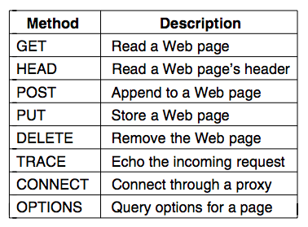
HTTP Request Methods
Specifies what a HTTP Request will do
GET filename HTTP/1.1

Slide 7
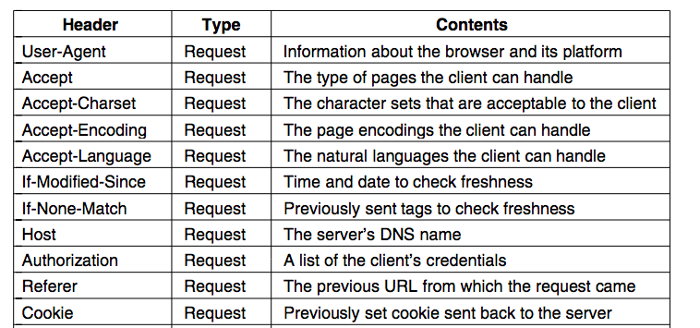
HTTP Request Header Fields (Partial List)

Slide 8
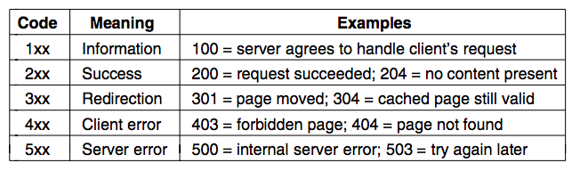
HTTP Response
Specifies the status of the request message.

Slide 9
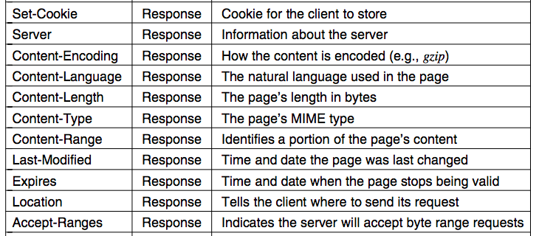
HTTP Response Header Fields (Partial List)

Slide 10
HTTP Proxy
Intercepts the TCP connections to process the HTTP data.
HTTP Proxy

Slide 11
File Transfer Protocol (FTP)
Is built on a client-server model (RFC 959)
The client requests for the file or send the file to the server
The server responses with the file data or store the file at the file server
Works in two modes – Active and Passive
User
(FTP Client)
File Request
File Server
(FTP Server)
File Response Status
File Data

Slide 12
Active and Passive Modes of File Transfer
FTP server uses two different ports:
Port 21 (Command or Control Port): For command message transfer
Port 20 or Client assigned (Data Port): For data transfer
Image Source: http://henrydu.com/blog/how-to/ftp-active-mode-vs-passive-mode-106.html

Slide 13
Why There are Two Channels – Command Channel and Data Channel
Specifically to avoid busy waiting, and keep the command channel lightweight.
You can always use a multiplexing between command/control and data, but FTP is used for large file transfer; if command channel is used for data transfer as well, the commands for other clients may experience a higher queuing delay while one client is being served.
The clients can continue sending and receiving control information while data transfer is being take place

Slide 14
Why There are Two Modes in FTP?
Active Mode: Client informs the port number where it is listening, and the server initiates the TCP connection to that port (TCP server is running at the client side)
What If the client is behind a firewall and can not accept a connection?

Slide 15
Why There are Two Modes in FTP?
Passive Mode: The server selects a random port, and the client initiates a TCP connection to that server port.
The server can serve multiple clients at different server data ports through different threads.
The clients always initiate the command and the data transfer.
Image Source: http://henrydu.com/blog/how-to/ftp-active-mode-vs-passive-mode-106.html

Slide 16
FTP Data Transfer Modes
Stream mode: Data is sent as a continuous stream, relieving FTP from doing any processing. Rather, all processing is left up to TCP. No End-of-file indicator is needed, unless the data is divided into records.
Block mode: FTP breaks the data into several blocks (block header, byte count, and data field) and then passes it on to TCP.
Compressed mode: Data is compressed using a simple algorithm (usually run-length encoding).
Source: Wikipedia

Slide 17
FTP Sample Commands and Response Codes

Slide 18
Assignment - HTTP
Three instances of HTTP server is running at 10.5.20.222
Port 8111
Port 8110
Port 8100
(a) HTTP 1.0 , (b) HTTP 1.1 with persistent connection, (c) HTTP 1.1 with non-persistent Connection
Your task would be to identify who’s who from the packet capture trace, and answer some related questions.
Note: Disable the browser cache from Developer mode options of your browser

Slide 19
Assignment - FTP
Connect to the FTP server running at 10.5.20.222
Transfer messages (simple messages like ls) using (a) active mode, (b) passive mode
Capture the packet traces, and observe the sequence of message transfers over data channel and control channel of FTP

Slide 20
How to Identify a TCP Connection – Connection Establishment

Slide 21
How to Identify a TCP Connection – Connection Closure

